Slide 1
Secure Data Hiding in Image Using Steganography
CAPSTONE PROJECT
Presented By: Aryan Deepak Ojha
Student Name : Aryan Deepak Ojha
College Name : Silver Oak College of Engineering & Technology
Department: Computer Science & Engineering (Cyber Security)

Slide 2
OUTLINE
Problem Statement
Technology used
Wow factor
End users
Result
Conclusion
Git-hub Link
Future scope

Slide 3
Problem Statement
• In the digital world, data security is crucial for protecting sensitive information from unauthorized access.
• Existing encryption methods may be detectable and vulnerable to interception.
• Steganography provides a more discreet method of hiding data by embedding it into innocuous-looking images.
• The challenge is to design a secure, efficient, and undetectable method for hiding sensitive data within images.

Slide 4
Technology used
• Programming Language: Python
• Libraries:
- OpenCV: For image processing.
- NumPy: For numerical operations.
- PIL (Pillow): For handling images.
• Concepts Used:
- Least Significant Bit (LSB) Encoding: A method of embedding data in the least significant bits of image pixels.
• Tools: Jupyter Notebook for coding, GitHub for version control.

Slide 5
Wow factors
• Steganography is extremely hard to detect by conventional detection methods.
• The hidden data can remain completely undetected while maintaining high image quality.
• A versatile method that can hide text, images, and files.
• Utilizes a custom algorithm that enhances the security of the hidden data.
• The project aims to combine security with seamless user experience.

Slide 6
End users
• Cybersecurity Professionals: For secure communication and data transmission.
• Government & Military: Protects confidential information against unauthorized surveillance.
• Journalists & Whistleblowers: Enables secure transmission of sensitive information to prevent leaks.
• Individuals: Everyday users can hide personal data like passwords and private messages securely.
• Corporations: For protecting intellectual property or trade secrets.

Slide 7
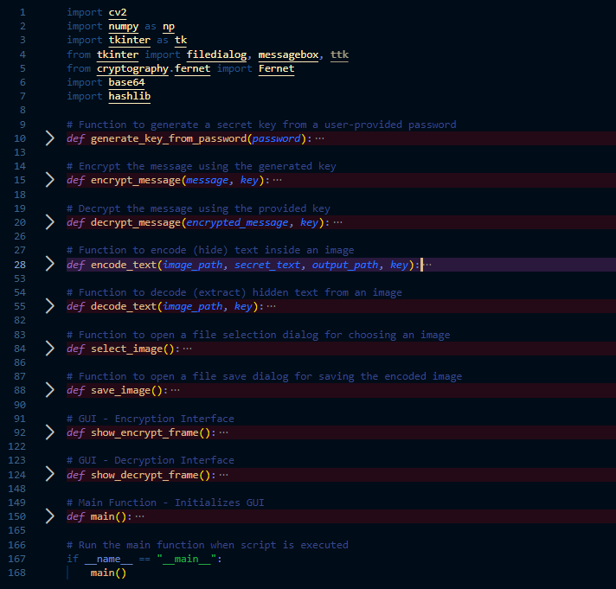
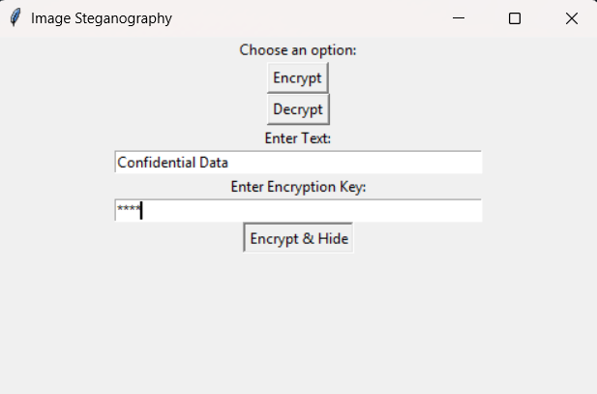
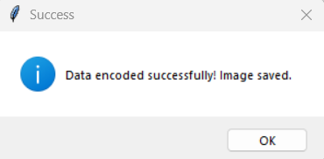
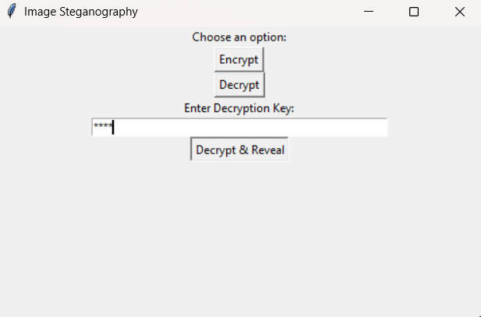
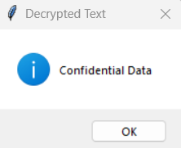
Results
Python Code
Encryption GUI
Data Encryption
Decryption GUI
Data Decryption

Slide 8
Conclusion
• Steganography provides an additional layer of security in data transmission, especially when combined with encryption.
• The method hides data in a way that is not easily detectable by traditional data analysis methods.
• The system is efficient, lightweight, and suitable for a variety of practical applications in cybersecurity.
• Steganography can be a game-changer in secure communication and data privacy.

Slide 9
GitHub Link
https://github.com/AryanOjha09/Steganography.git

Slide 10
Future scope
• Enhancing Steganography with AI and Machine Learning for smarter data hiding techniques.
• Implementing steganography in videos and audio files for richer multimedia content.
• Integrating blockchain technology for decentralized and immutable secure data hiding.
• Real-world applications: Secure messaging platforms, digital forensics, data protection in cloud storage.
• Further exploration into adaptive algorithms that modify hiding techniques based on the carrier image.

Slide 11
THANK YOU

